Slide 1
Debugging in angular
Team-2

Slide 2




AGENDA
Create
Create an Angular application
Click on
Click on Run and Debug to add new configuration
Add
Add an component.ts file
Add
Add a Breakpoint
Debugging
Start Debugging

Slide 3
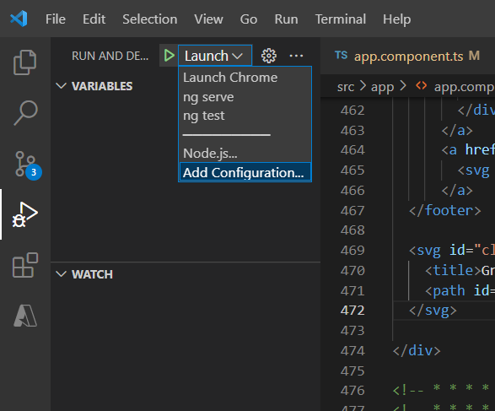
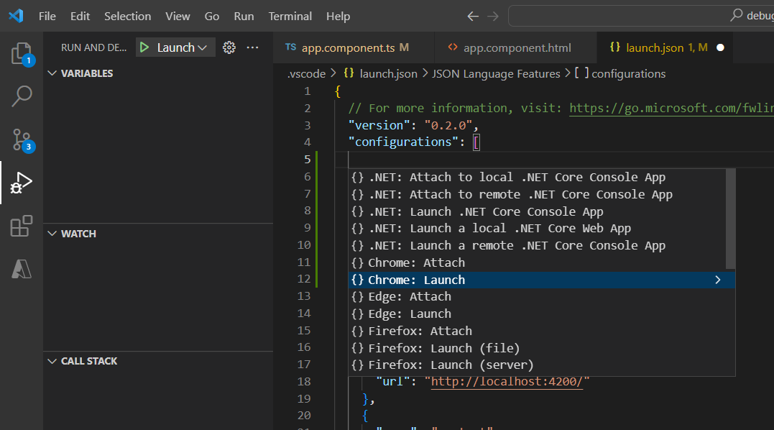
Step 2:

Slide 4
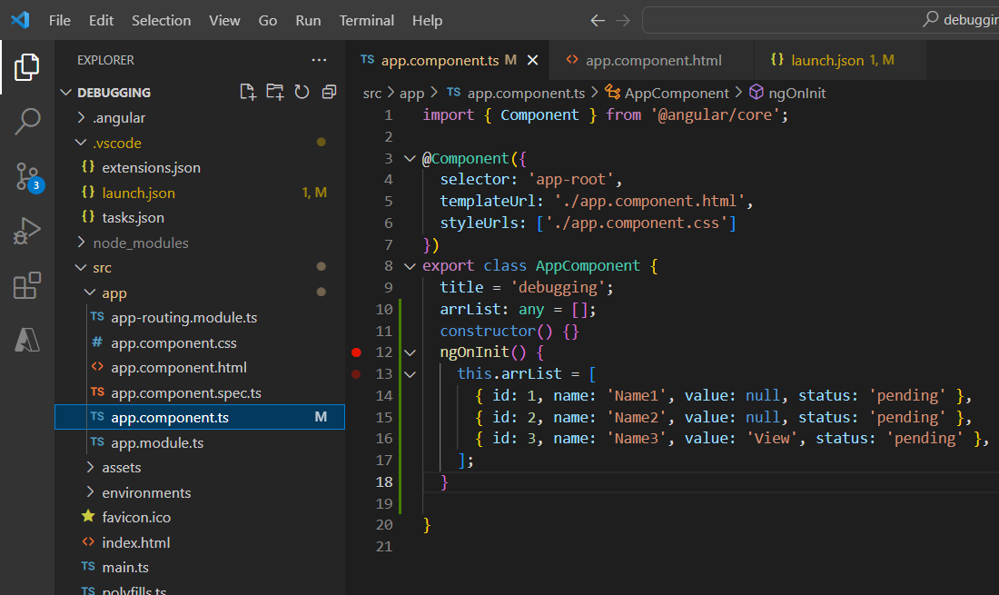
Step 3:

Slide 5
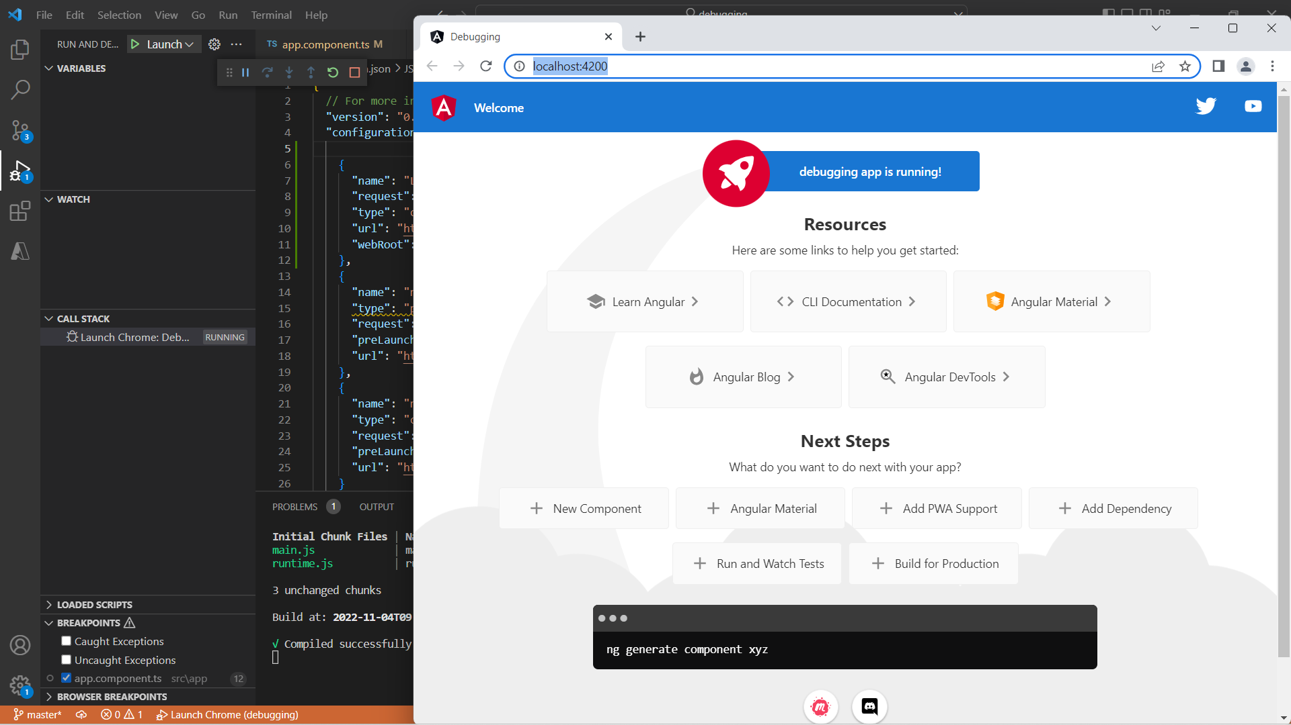
Step 4:

Slide 6


THANK YOU

